Slide 1

Cyclistic Bike Share Analysis: Turning Casual Riders into Annual Members
by Patrick Sebastine
July 2024

Slide 2

Problem & Solution
Problem
Solution
Our marketing team believes the company's future growth lies in increasing annual memberships. We need to understand how casual and annual members use our bikes differently.
Develop targeted strategies to convert casual riders into annual members, ensuring long-term customer retention and revenue growth.

Slide 3

Background
1
Cyclistic Operations
2
Membership Types
Cyclistic operates 5,824 bicycles across 692 docking stations in Chicago.
Two membership types: Casual (single-ride or full-day passes) and Annual.
3
Flexible Pricing
4
Goal
Flexible pricing already in place for casual riders.
Create an effective marketing campaign to convert casual riders to annual members.

Slide 4
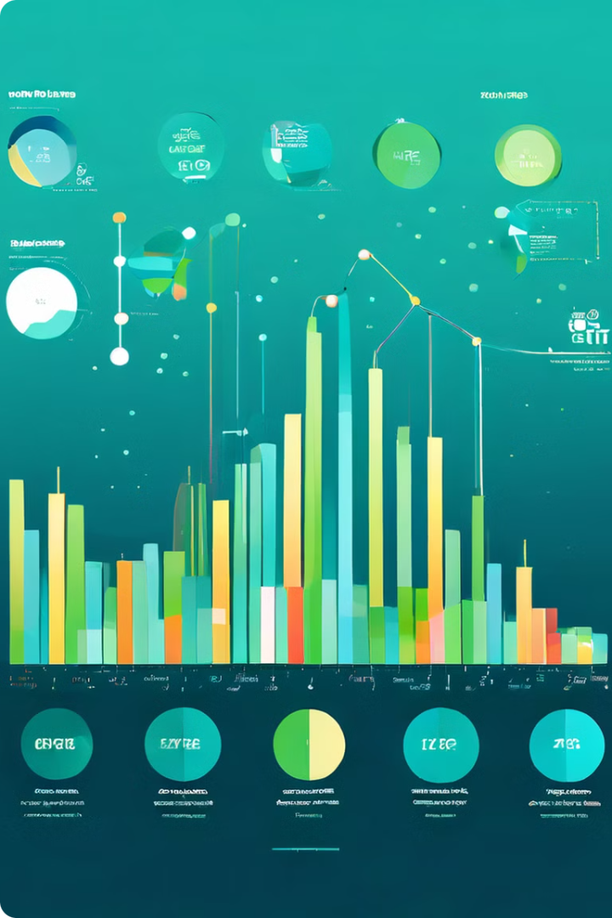
Dataset Overview
1
Comprehensive Dataset
Comprehensive dataset spanning June 2013 to June 2024.
2
Trip Volume
Total trips recorded: 44,178,477.
After data cleaning: 44,161,499.
3
Data Columns
12 fields columns including trip details, station information, and user demographics.

Slide 5

Analysis Goals
WHY
Understand the reasons casual members don't commit to annual memberships.
HOW
Analyze the differences in usage patterns between casual and annual members.

Slide 6
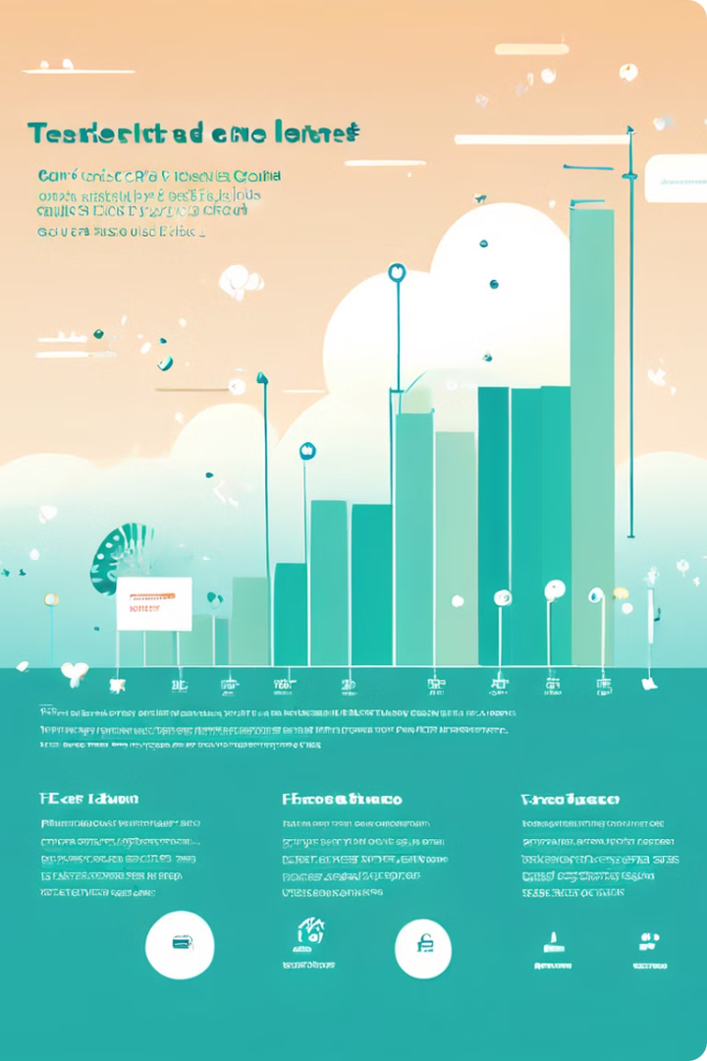
WHY Analysis
Cost Concerns
Flexibility Needs
Seasonal Usage
Key findings from our analysis on why casual riders hesitate to
become annual members
Insights into perceived barriers and misconceptions about
annual memberships
Opportunities identified to address these concerns through
targeted marketing and product offerings

Slide 7




HOW Analysis
Ride Frequency
Trip Duration
Popular Times
Casual riders often take longer rides compared to annual members.
Highlight significant differences in usage patterns.
Identify behaviors of casual riders that align closely with annual members, indicating potential for conversion.

Slide 8

Key Insights
1
Peak Usage Days
2
Ride Duration and Distance
3
Seasonal Trends
Casual ridership spikes during summer months.
Casual riders predominantly use the service on weekends.
Casual riders often take longer rides compared to annual members.
4
Frequent Riders
5
Referral Impact
A subset of casual riders show similar patterns to annual members.
Annual members form 67% of company patronage, indicating strong potential for referral programs.

Slide 9






Recommendations
Weekday Promotions
Long-ride Packages
Seasonal Campaigns
Introduce special rates for casual riders on less busy weekdays.
Develop annual membership tiers that cater to riders who prefer longer trips.
Launch targeted conversion campaigns during peak seasonal usage.
Enhanced Referral Program
Personalized Offers
Implement a dual-incentive system rewarding both annual member referrers and new annual members.
Use data analytics to identify and target frequent casual riders, then offer tailored membership proposals.

Slide 10
THANK YOU

